Slide 1

Learning Optimal “Go” Play with ML
By: William Abbot and Jason Barbieri

Slide 2
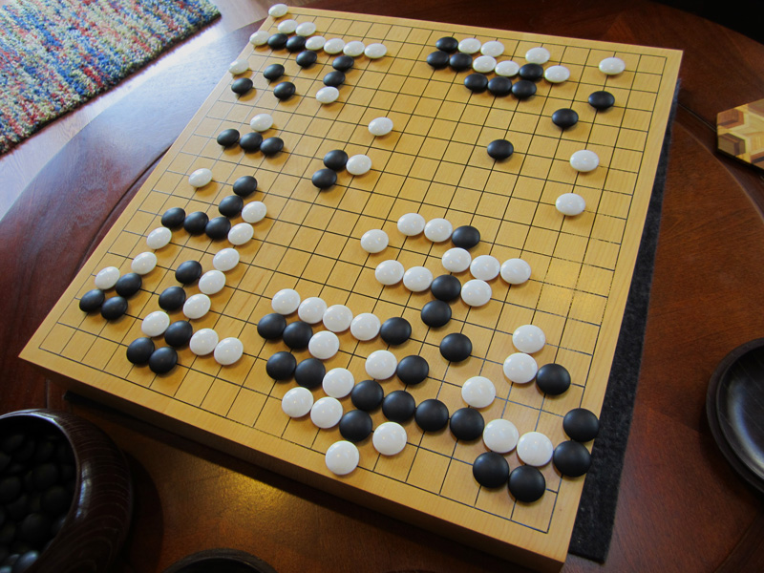
Background
Very old board game
Focuses on capturing pieces and controlling territory
Very difficult to solve
Strongly solved on 5x5 board
Weakly solved on 7x7 board
Unsolved for higher boards

Slide 3
Goals
Use an ML model to learn perfect play on 5x5 board
1
See if trained model can perform well on a 7x7 boards
2

Slide 4

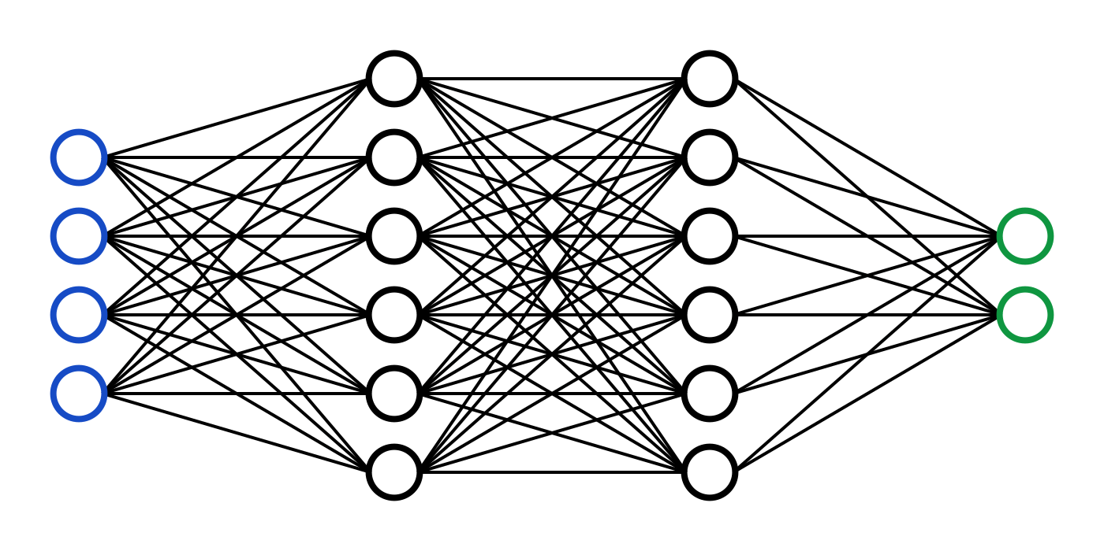
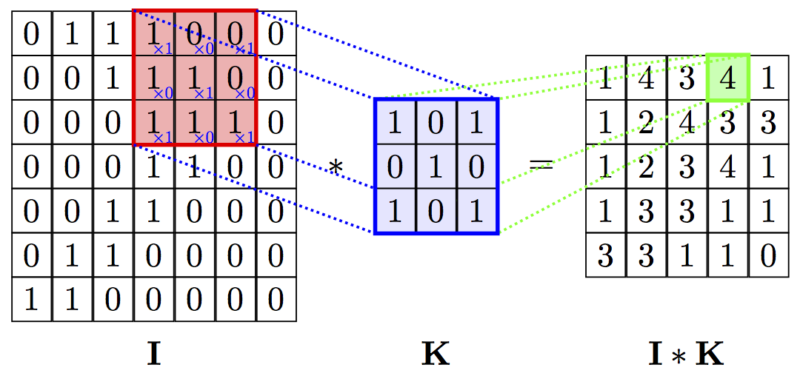
Model
Neural Network
Multilayer
Multiclass
5 * 5 = 25 inputs (1 per board space)
25 outputs (1 per board space)
Convolve 7x7 board to fit into 5x5 model

Slide 5
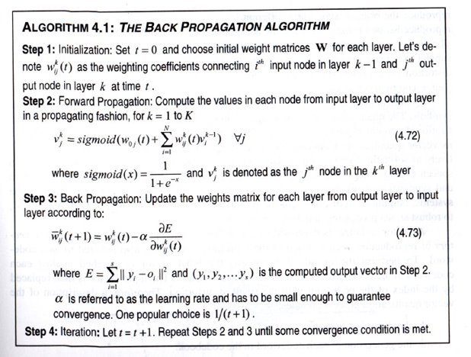
Back Propagation

Slide 6
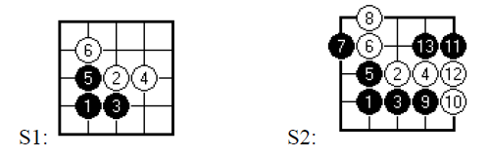
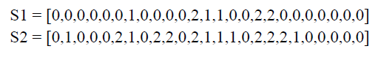
Inputs
Σ = {0, 1, 2}
0 = empty cell
1 = white tile
2 = black tile
Each input node gets 1 cell
i.e. node 1 => cell (1, 1), node 2 => cell (1, 2), etc.

Slide 7
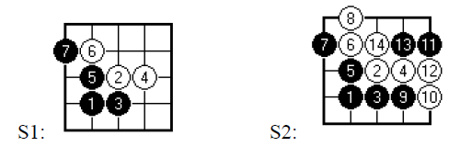
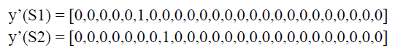
Outputs
Σ = {0, 1}
0 = no tile placed
Model selects cell based on highest activated output
i.e. output node 1 => place tile in cell (1, 1)
1 = tile placed in that cell

Slide 8
Training
All instances taken from optimal play algorithm by MacroUniverse on Github
Board state recorded before move is played
Optimal move recorded as array

Slide 9
Testing
70/30 training/testing sets
Ensure learned behavior is consistent
Play against optimal opponent
Model should win every time when in a favorable position
Play against sub-optimal opponent
i.e. opponent sometimes makes a random move
Model should win most times
Play against random opponent
Model should win every time

Slide 10
Preliminary Results (5x5 Board)
~85% on training set
~70% on testing set
Based on unoptimized model
Has won games against a sub-optimal opponent

